Slide 1
Thomas Simmons
Games Designer

Slide 2
Role on the project
Research into Character design and what potential users want to use in the app
Managing The design aspects and setting weekly tasks on Trello
3D Modelling the following:
Our Character Avatar
Assets to be used for Avatars environment
Visual customisation towards the Avatar
Photo Realistic Textures for the Avatar, Customisations and Assets using methods such as:
Colour Maps
Bump/Normal Maps
Self Illumination Maps
Specular Maps
The use of Adobe Substance Painter

Slide 3
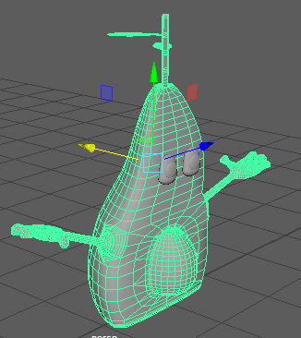
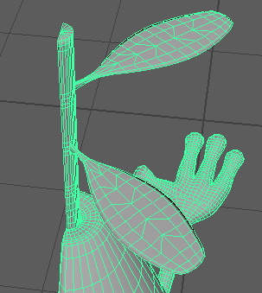
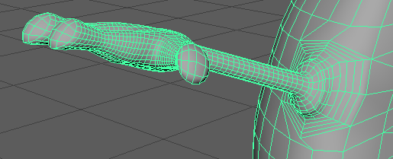
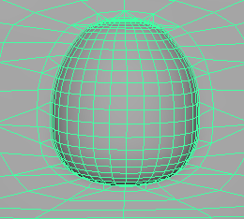
Player/ Users Avatar
Playable Living Avocado
Stalk and Leaves
Rounded Arms
Tools used
Capable of being Animated
Future development
Software used

Slide 4
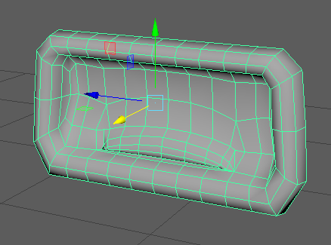
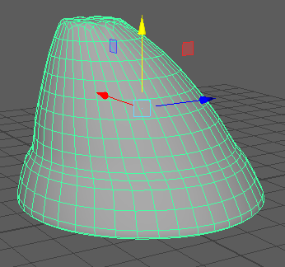
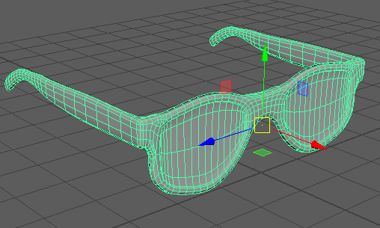
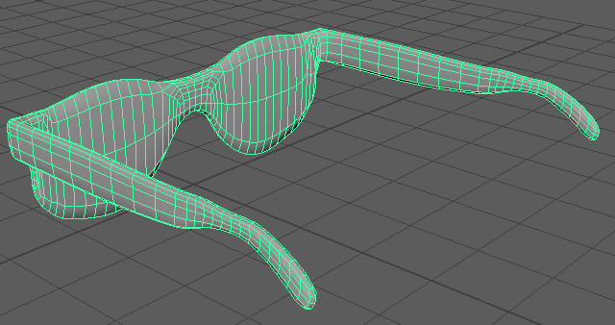
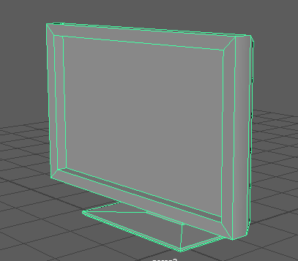
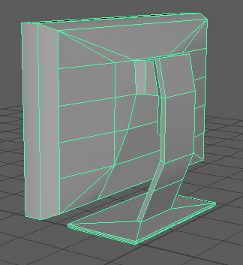
Features and Assets
Mouth ready to animate
Beanie Assets
Sunglasses Assets
Bedroom Assets
Tools required
Software used

